Slide 1
Angular
Components

Slide 2
Agenda
Basics
NgModule
Component Decorator
Styling Components
Component Lifecycle

Slide 3
Angular
1
Basics of a component

Slide 4
A Component
Building block of your application
Component === Module
Component === UI Element (HTML, CSS, ...)
The application itself is also a component
Top-level component
Can be used by other Components

Slide 5
A Component
Each component is composed of three parts
Component Decorator
View
Controller

Slide 6
Most basic Component
import {Component} from '@angular/core';
@Component({
selector: 'component',
template: `your html`,
styles: [`your css`]
})
export class Component{
message: string = "...";
}

Slide 7
Most basic Component
import {Component} from '@angular/core';
@Component({
selector: 'component',
template: `your html`,
styles: [`your css`]
})
export class Component{
message: string = "...";
}
A component always has
at least 1 import.

Slide 8
Most basic Component
import {Component} from '@angular/core';
@Component({
selector: 'component',
template: `your html`,
styles: [`your css`]
})
export class Component{
message: string = "...";
}
Component annotation
Associated with the class below it
Also called the decorator

Slide 9
Most basic Component
import {Component} from '@angular/core';
@Component({
selector: 'component',
template: `your html`,
styles: [`your css`]
})
export class Component{
message: string = "...";
}
Definition of the component class
Export makes it available for other components

Slide 10
Angular
2
NgModule

Slide 11
Module
Mechanism to group components, directives, pipes and services
Module A can make use of Module B, ...

Slide 12
NgModule
Organize an application into building blocks
Syntax (decorator function)
Tells angular how to compile and run module code
Defines the components, directives, pipes, ...
@NgModule({
imports: [ BrowserModule ],
declarations: [ AppComponent ],
bootstrap: [ AppComponent ]
})

Slide 13
The module of modules: the root module
Most of the time called the AppModule
import { BrowserModule } from '@angular/platform-browser';
import { NgModule } from '@angular/core';
import { AppComponent } from './app.component';
@NgModule({
declarations: [AppComponent],
imports: [BrowserModule],
providers: [],
bootstrap: [AppComponent]
})
export class AppModule { }

Slide 14
The module of modules: the root module
Most of the time called the AppModule
import { BrowserModule } from '@angular/platform-browser';
import { NgModule } from '@angular/core';
import { AppComponent } from './app.component';
@NgModule({
declarations: [AppComponent],
imports: [BrowserModule],
providers: [],
bootstrap: [AppComponent]
})
export class AppModule { }
Used components

Slide 15
The module of modules: the root module
Most of the time called the AppModule
import { BrowserModule } from '@angular/platform-browser';
import { NgModule } from '@angular/core';
import { AppComponent } from './app.component';
@NgModule({
declarations: [AppComponent],
imports: [BrowserModule],
providers: [],
bootstrap: [AppComponent]
})
export class AppModule { }
Every application needs to run in a browser

Slide 16
The module of modules: the root module
Most of the time called the AppModule
import { BrowserModule } from '@angular/platform-browser';
import { NgModule } from '@angular/core';
import { AppComponent } from './app.component';
@NgModule({
declarations: [AppComponent],
imports: [BrowserModule],
providers: [],
bootstrap: [AppComponent]
})
export class AppModule { }
Component(s) inserted in the host web page

Slide 17
Imports array
Angular provides a big set of features.
These features are organized in Angular modules
You need to add the module into the import array if you want to enable them
Only NgModule classes go in the imports array

Slide 18
Declarations array
Which components belong to the AppModule
Directives
Pipes
Every component needs to be declared

Slide 19
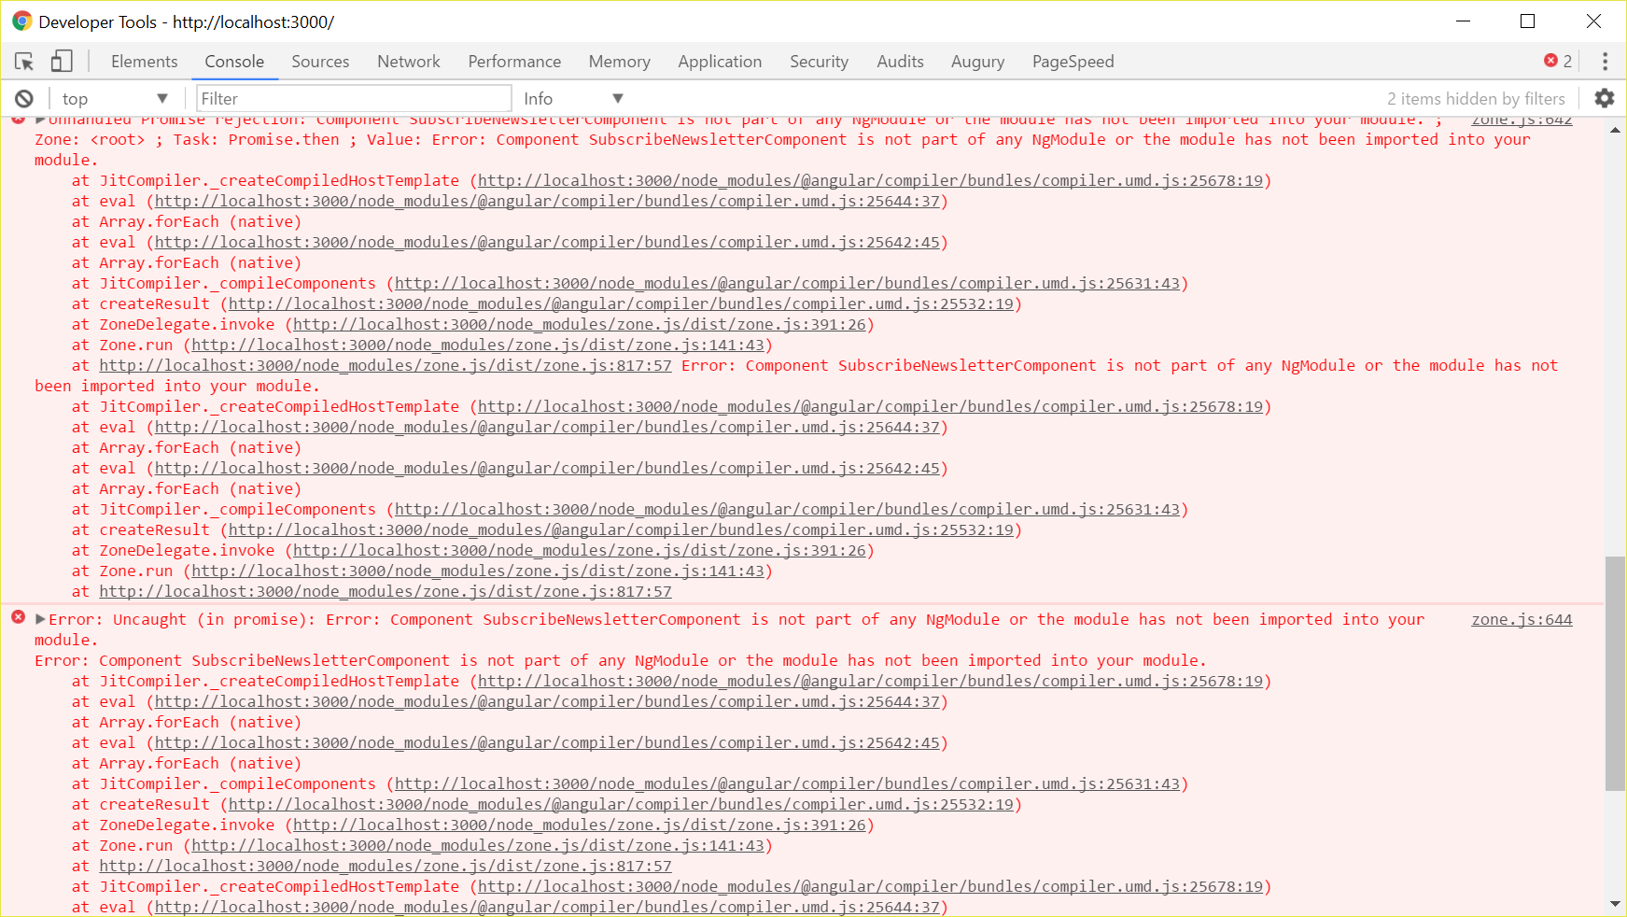
Module not declared

Slide 20
Bootstrap array
Bootstrapping: launching the application
List the components you want to insert into the browser DOM
Decide when you want to compile the application
Just In Time
Ahead Of Time
Notes:
You launch the application by bootstrapping the root AppModule. Among other things, the bootstrapping process creates the component(s) listed in the bootstraparray and inserts each one into the browser DOM.
Each bootstrapped component is the base of its own tree of components. Inserting a bootstrapped component usually triggers a cascade of component creations that fill out that tree.
While you can put more than one component tree on a host web page, that's not typical. Most applications have only one component tree and they bootstrap a single root component.
You can call the one root component anything you want but most developers call it AppComponent.

Slide 21
JIT vs AOT
JIT
Default
App is compiled at runtime
Runtime performance penalty
Application is bigger because it includes the compiler and library code
AOT
Pre-compiled version is downloaded to client
Fewer requests
Smaller download size

Slide 22
Bootstrap JIT
import { platformBrowserDynamic } from '@angular/platform-browser-dynamic';
import { AppModule } from './app/app.module';
platformBrowserDynamic().bootstrapModule(AppModule);

Slide 23
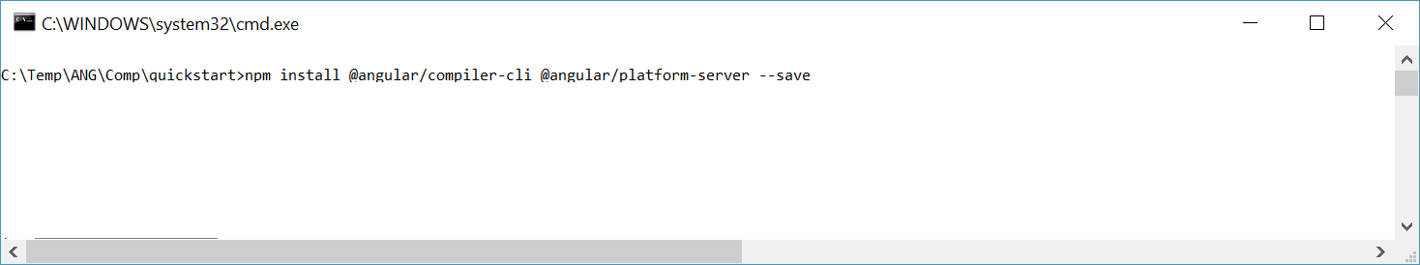
Bootstrap AOT

Slide 24
Angular
3
@component decorator

Slide 25
The @component decorator
Configure how our component interacts with other components...
Add metadata to the class
Specifies
A selector: Matches a specific element
A template: Defines the view

Slide 26
@Component Selector
Like CSS selectors target an HTML element, a Component selector points to a specific element
<course></course>
OR
<div course></div>
@Component({
selector: 'course'
})

Slide 27
@Component Template
The markup that the client will see
The HTML
@Component({
selector: 'course',
template: `<div>
<h1>Angular Course</h1>
</div>`
})

Slide 28
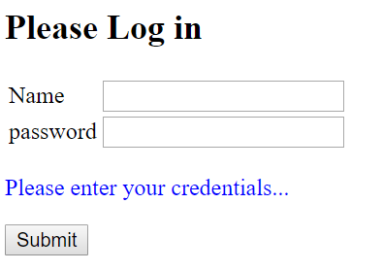
Exercise

Slide 29
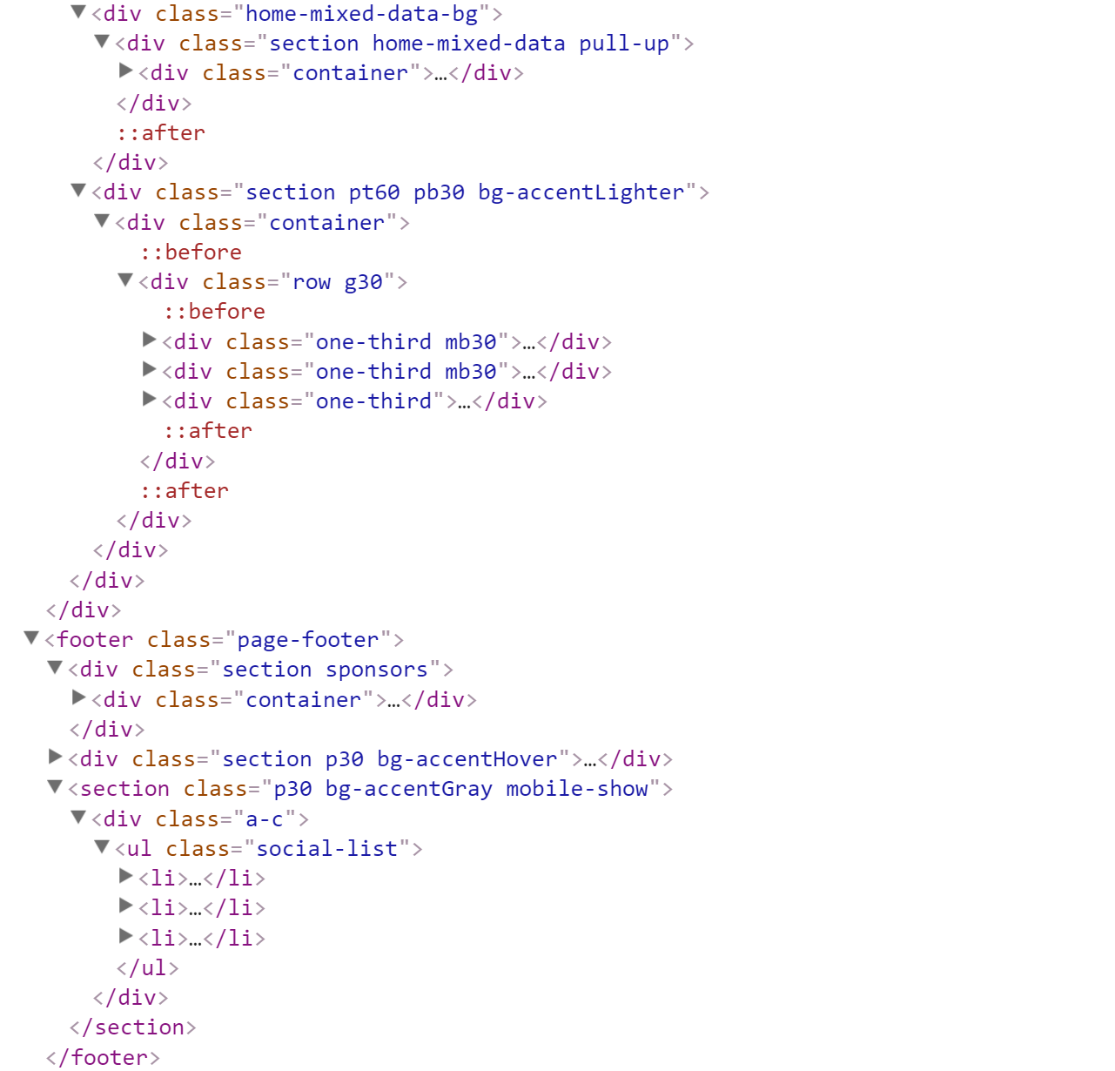


Slide 30
@Component Template
The markup that the client will see
The HTML
@Component({
selector: 'course',
templateUrl: './course.component.html'
})

Slide 31
More properties
Styles: array of CSS style definitions
StyleUrls: array of file names pointing to CSS style files
Directives: defines directives for use in HTML templates
Providers: defines objects for injection into the component

Slide 32
Angular
4
Styling components

Slide 33
Styling
Global styling vs Component specific styling
2 ways of component styling
Via styles property
Via styleUrls

Slide 34
@Component({
selector: 'app-demo',
styles: [`
.active{
color: orange
}
`]
})
@Component({
selector: 'app-demo',
styleUrls: ['./app.component.scss']
})

Slide 35
Shadow DOM Encapsulation
Each component has its own unique DOM tree that is hidden from the other elements on the page
Styles defined within that element are invisible to the rest of the page

Slide 36
ElementRef
The host element where a directive is bound to
Holds information about a given angular element

Slide 37
Angular
5
Component lifecycle

Slide 38
Lifecycle hooks
Allow you to execute code before or after each step of the component lifecycle
onInit
onDestroy
doCheck
onChanges
afterContentInit
afterContentChecked
afterViewInit
afterViewChecked
Every method name is ng + name of the hook → ngOnInit

Slide 39
OnInit and OnDestroy
OnInit
When you directive properties have been initialized
Before the child directive properties are initialized
OnDestroy
When the instance is destroyed
For CleanUp

Slide 40
export class CustomerComponent implements OnInit, OnDestroy {
ngOnInit(): void {
//Called after the constructor, initializing input properties,
//and the first call to ngOnChanges.
//Add 'implements OnInit' to the class.
}
ngOnDestroy(): void {
//Called once, before the instance is destroyed.
//Add 'implements OnDestroy' to the class.
}
}

Slide 41
OnChanges
Called after one or more of our component properties have been changed
Receives a parameter which indicating the changed property
ngOnChanges(changes: SimpleChanges): void {
//Called before any other lifecycle hook. Use it to inject dependencies,
//but avoid any serious work here.
//Add '${implements OnChanges}' to the class.
}

Slide 42
DoCheck
Triggered every time the Angular change detection mechanism notices there was a change

